Slide 1
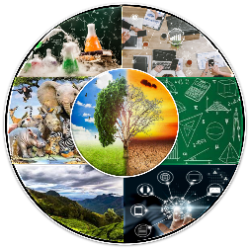
3rd International Conference of Sciences
“Revamped Scientific Outlook of 21st Century, 2024 (RSO-21st Century, 2024)

